Slide 1

Exploratory Data Analysis
G2M insight for Cab Investment firm
<Mar 23, 2024>

Slide 2
Agenda
Executive Summary
Problem Statement
EDA
Recommendations

Slide 3
Executive Summary
Background: XYZ is a private firm in US, it is planning for an investment in Cab industry and as per their Go-to-Market(G2M) strategy they want to understand the market before taking final decision.
Objective: Summarizes the analysis and recommendations and identify which company is performing better and is a better investment opportunity for XYZ.
Dataset:
Cab_Data.csv – this file includes details of transaction for 2 cab companies
Customer_ID.csv – this is a mapping table that contains a unique identifier which links the customer’s demographic details
Transaction_ID.csv – this is a mapping table that contains transaction to customer mapping and payment mode
City.csv – this file contains list of US cities, their population and number of cab users

Slide 4
Problem Statement
Which Company has higher profitability?
Do Customers Prefer Yellow Cab to Pink Cab?
Which Company has more loyal customers?
Which Company prevails in which city?
will Yellow Cab make more profit in the future?

Slide 5
EDA
Demographic Influence: How do customer demographics such as income level affect cab usage patterns?
Geographic Analysis: What is the user base as well as revenue status of both companies in various cities?
Customer Loyalty and Segmentation: Can we identify loyal customer segments based on repeated usage patterns?
Price Sensitivity: Are there differences in the average price charged per kilometer between the two cab companies, and what might this indicate about their pricing strategies or customer preferences?
Profitability Analysis: Which company shows better operational efficiency based on the ratio of price charged to the cost of the trip?

Slide 6
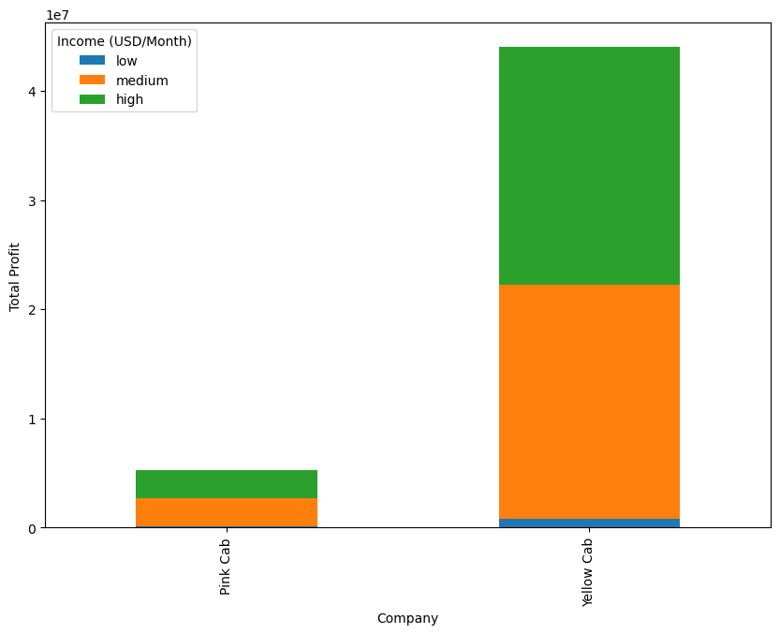
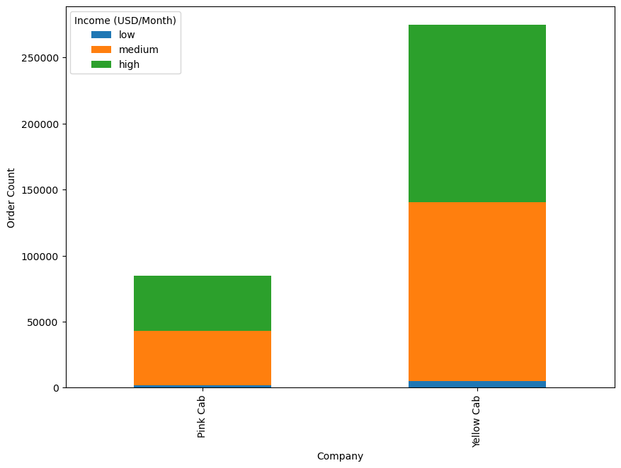
Demographic Influnence
Whatever in terms of total proficient or total number of orders, Yellow Cab performs much better than Pink Cab.
For each company, the proportions of medium and high income customers are higher, and their preference is Pink Cab.

Slide 7
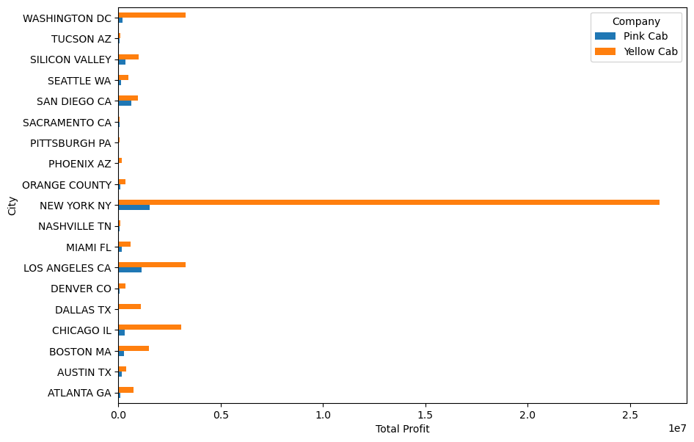
Geographic Analysis
For each city, the total profit of Yellow Cab is higher than Pink Cab.

Slide 8
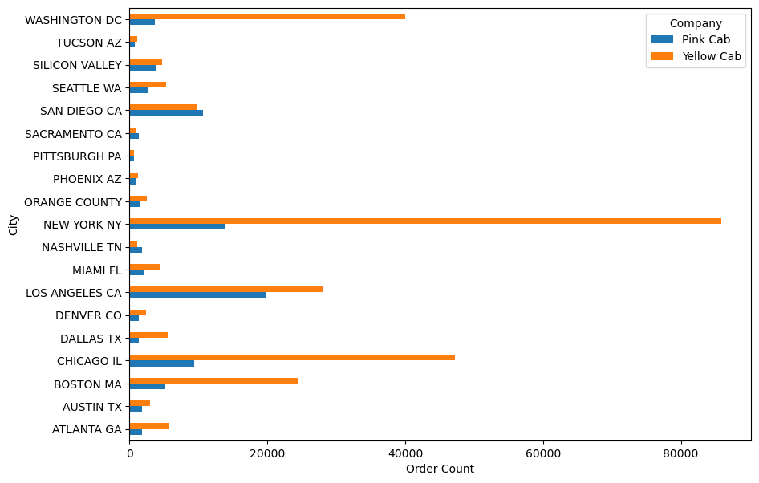
Geographic Analysis
Except San Diego, Sacramento and Nashville, the number of orders of Yellow Cab is higher than Pink Cab in all other cities.

Slide 9
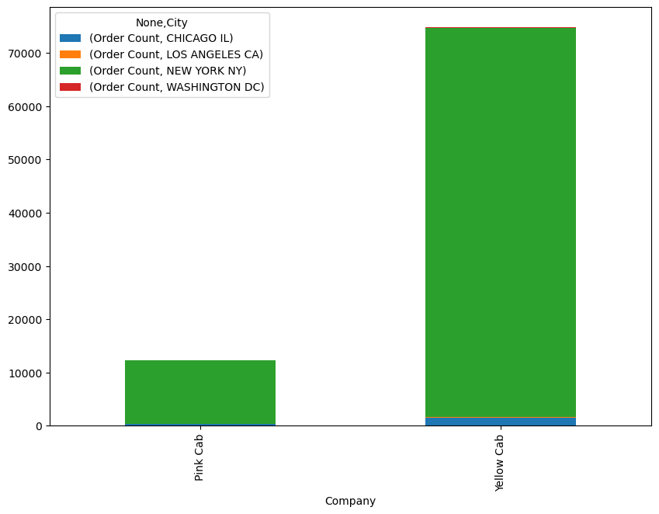
Customer Loyalty and Segmentation
Sort all passengers by number of orders and take the top 10% of customers as loyal customers
The mumber of loyal customers of yellow cab is much more than the number in pink cab.
Both firms have a large number of loyal customers in New York and Chicago (Yello cab has more), while Yellow also has some loyal customers in Los Angeles and Washington DC

Slide 10
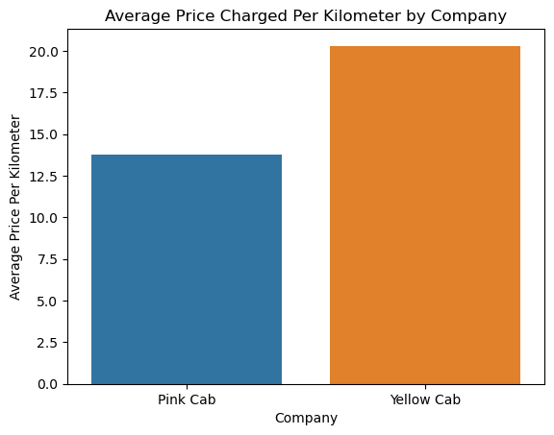
Price Sensitivity
The avarage price charged per kilometer of Yellow Cab is higher than Pink Cab.
It could suggest that Yello Cab may be positioned as a premium service.
Combined with the analysis about the proportion of customer monthly income, Yello cab may be more in line with middle and high income customers.

Slide 11
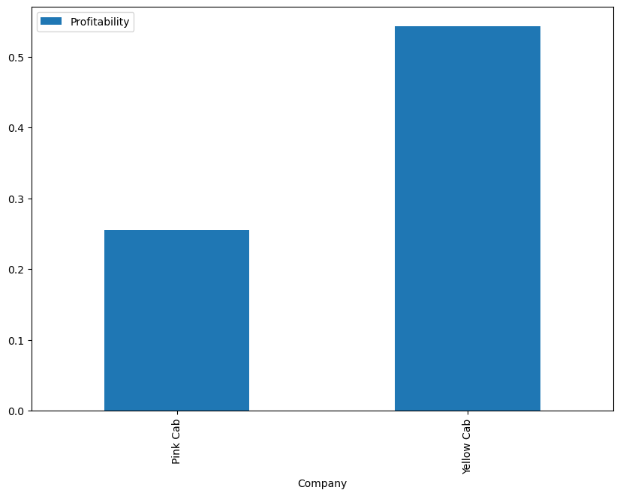
Profitability Analysis
Profitability = (Price charged - Cost of Trip) / Cost of Trip
The profitability of Yellow Cab is higher than Pink Cab.
Yellow Cab turns a greater portion of its revenue into profit compared to the other company.

Slide 12
Recommendations
Which Company has higher profitability? Yellow Cab
Do Customers Prefer Yellow Cab to Pink Cab?
Yes. Based on the number of orders and total profit, customers prefer Yellow Cab, especially medium and high income customers.
Which Company has more loyal customers? Yellow Cab
Which Company prevails in which city?
Even though the number of orders of Pink Cab is higher than Yellow Cab in San Diego, Sacramento and Nashiville, Yellow Cab still makes more overall profit in all cities, especially in New York.
Will Yellow Cab make more profit in the future?
Based on prior analysis from different aspects, Yellow Cab has considerable advantages.
On the basis of analysis, I will recommend Yellow Cab for investment.

Slide 13
Thank You

